Slide 1
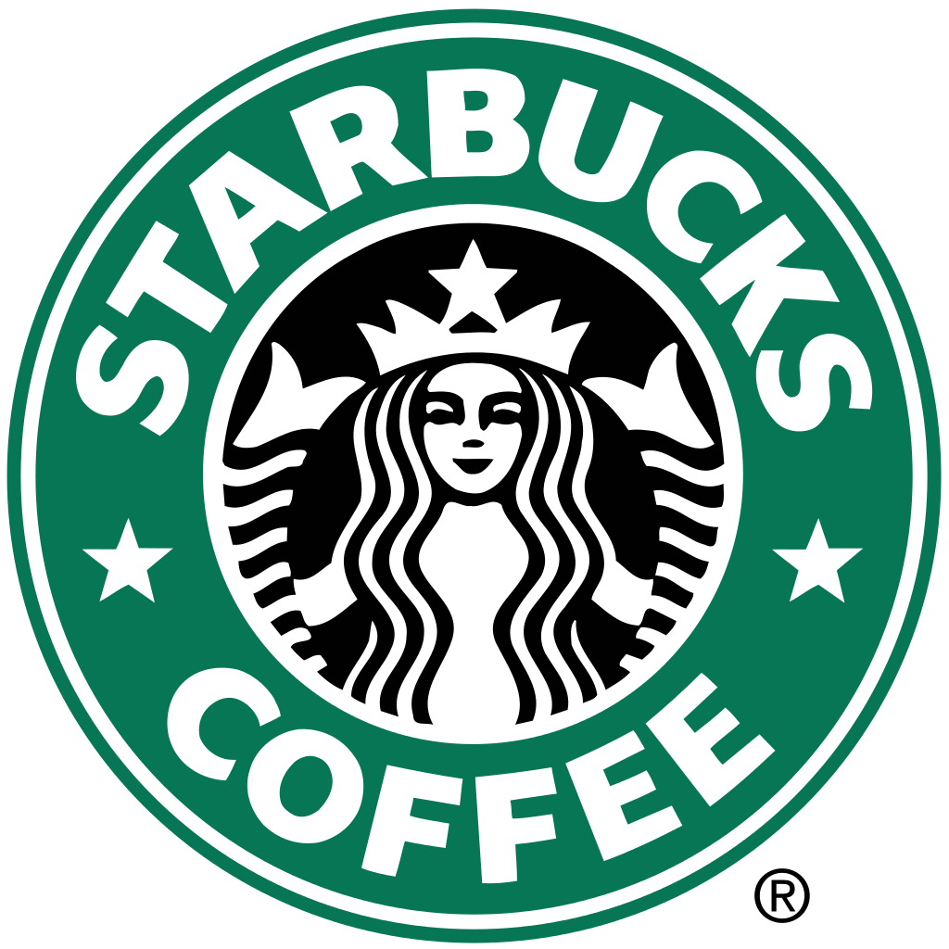

Slide 2
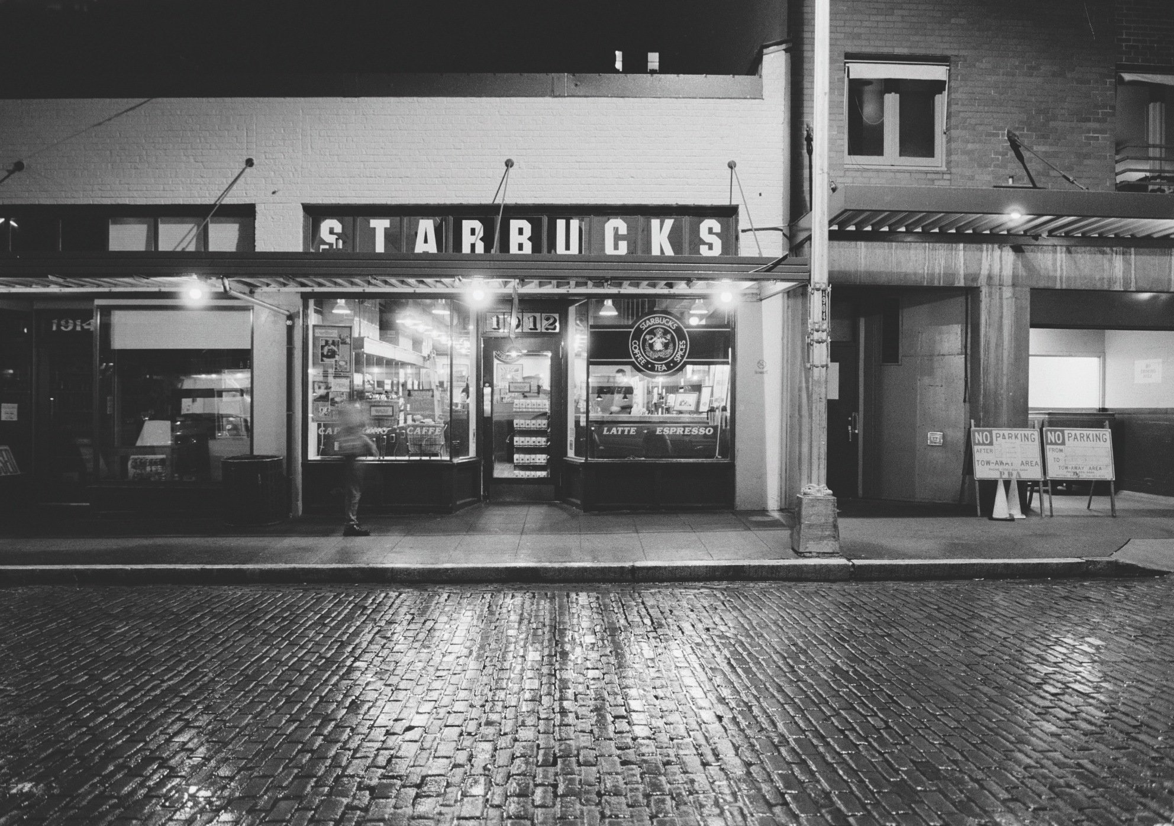
Story
Created in 1917 in Seattle

Slide 3
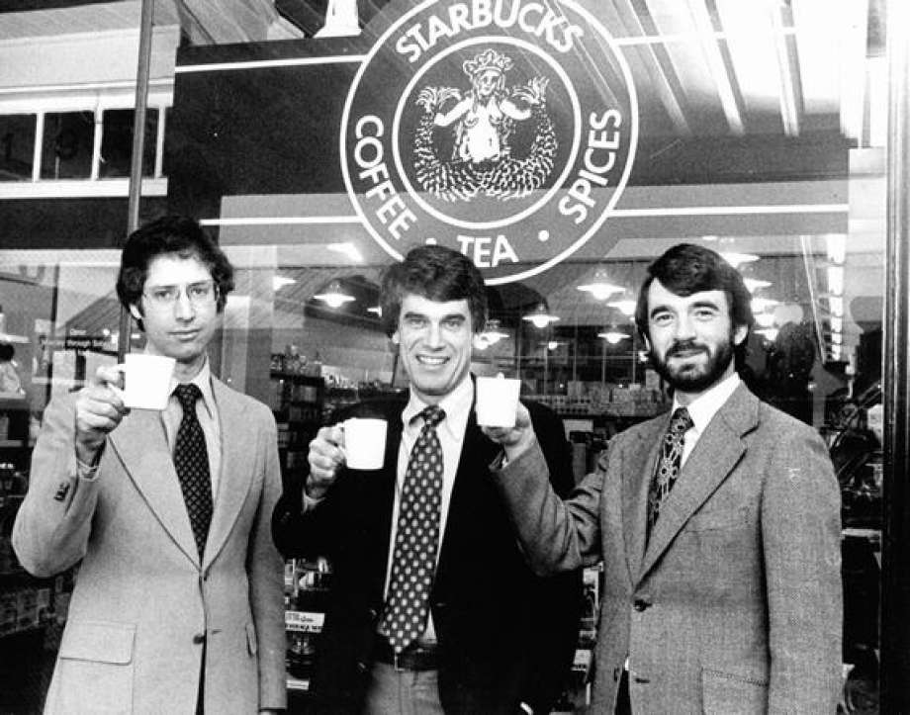
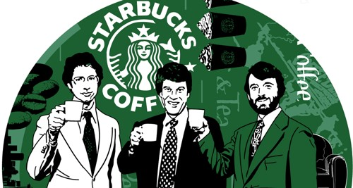
3 partners an English teacher Jerry Baldwin , an History teacher Zev Siegl and a Writer Gordon Bowker

Slide 4
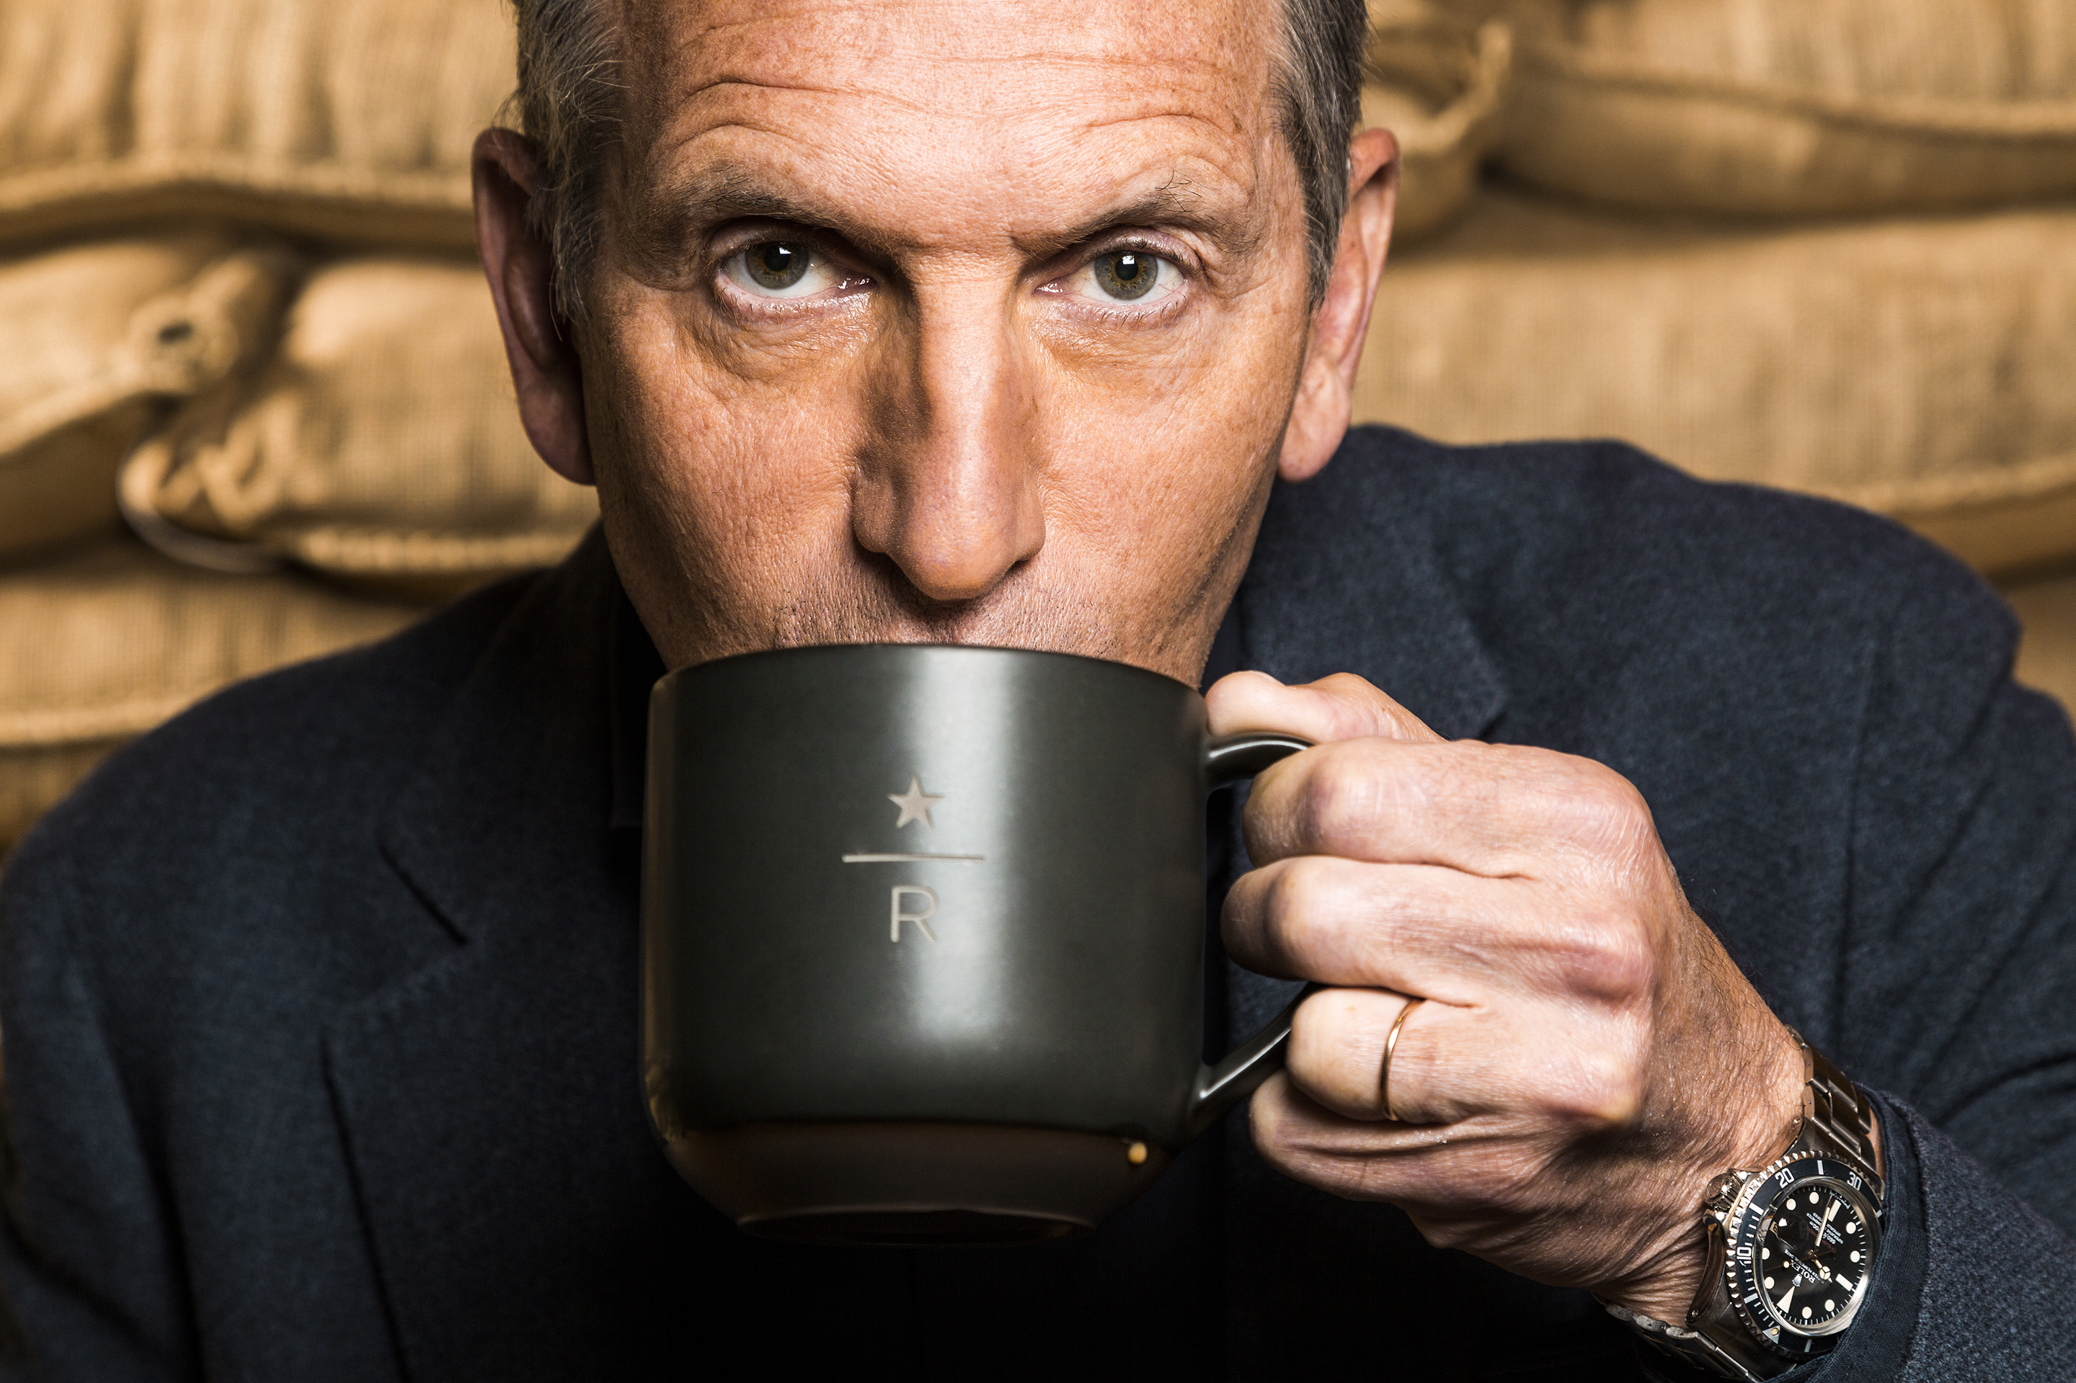
In 1983, Howard Schultz transposed in the United States the tradition of Italian cafes

Slide 6
Competitor
Balzac Coffe, an German company
Mc Donald’s
Costa Cofee

Slide 7
Where does its success come from ?
Starbucks is the most famous store of coffee on the world because of the quality of his coffee bean. The Starbucks chain is committed to buying coffee from Fairtrade producers in order to achieve quality while respecting the worker.
Starbucks also writes the name of the customer on his goblet, but misspelled spells to stand out, and have a little something stuff compared to the conpetitors.

